Slide 1
Chicago Crime Analysis
-Kaushik Paranjpe

Slide 2
Problem Statement: Analysis of the Chicago Crimes dataset
Explore the data based on various features such as crime type, year, and so on
Based on exploration, analyse the crimes data and check how the crimes varied over the years
Classify the crimes that leads to arrest and that does not

Slide 3
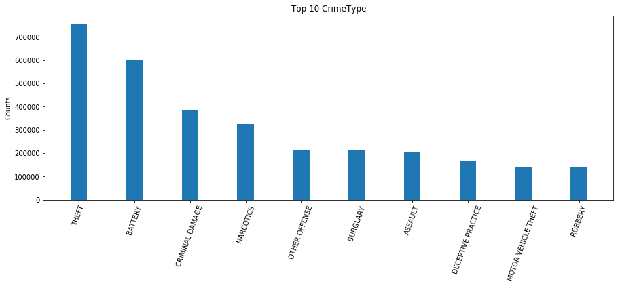
Exploratory Data Analysis
Counts grouped by CrimeType Top10

Slide 4
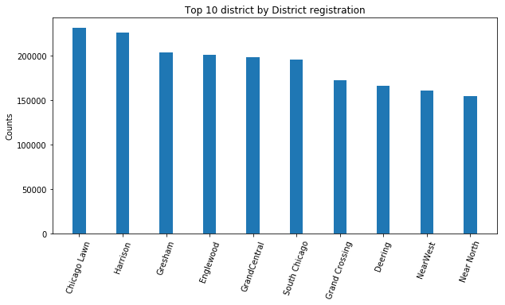
EDA Continued
Counts grouped by District Top10
Implemented In-memory Join to fetch Districts

Slide 5
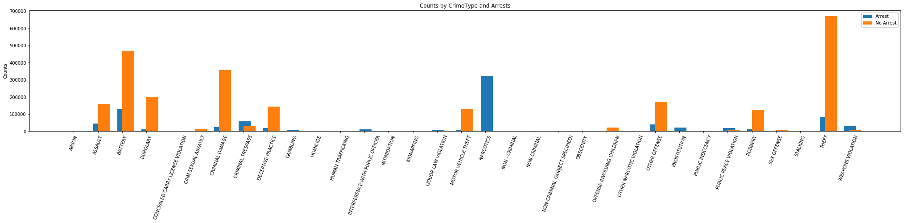
EDA Continued
Counts grouped by CrimeType and Arrest Flag

Slide 6
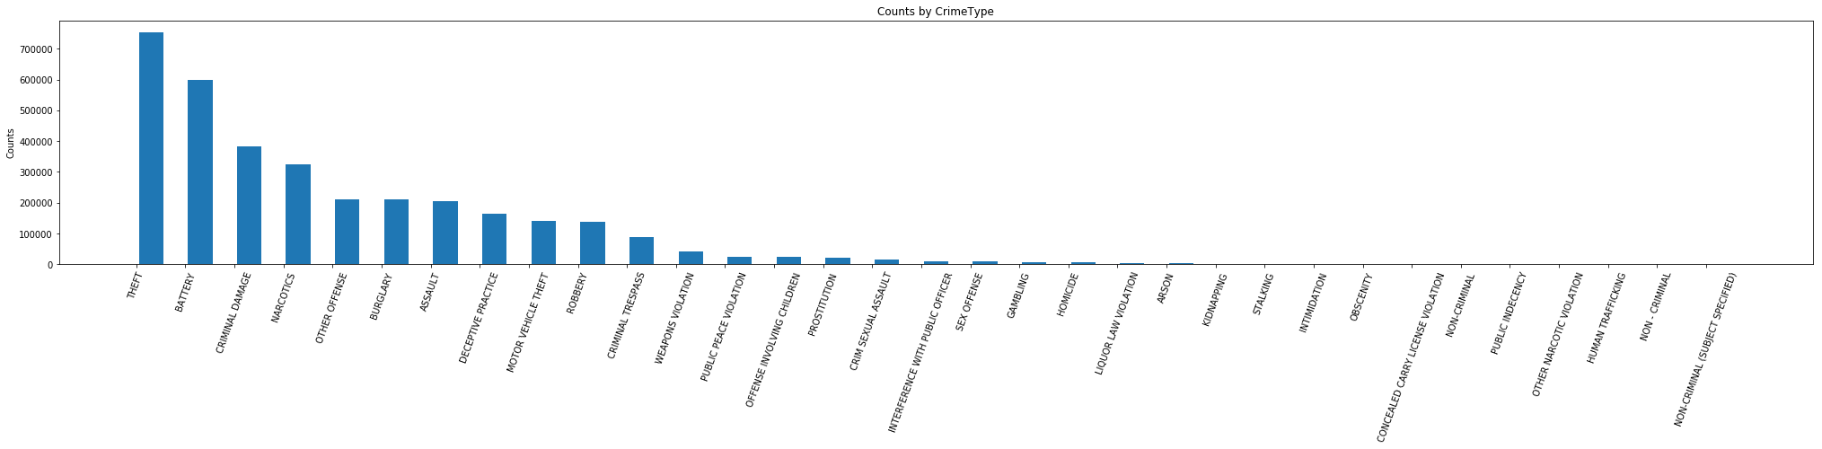
EDA Continued
Counts grouped by CrimeType

Slide 7
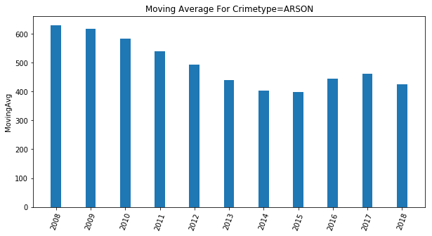
Moving Average
Moving Average for CrimeType “Assault” by Year/Month for Time Interval = 3

Slide 8
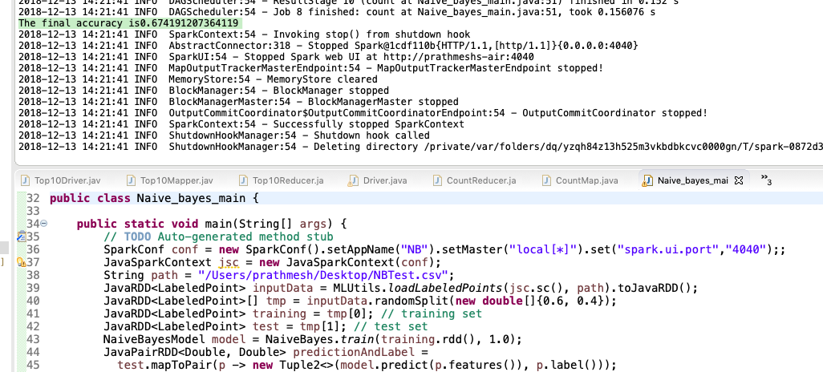
Naive Bayes Classification

Slide 9
References
https://spark.apache.org/docs/2.2.0/mllib-naive-bayes.html
https://www.safaribooksonline.com/library/view/data-algorithms/9781491906170/ch01.html
Dataset:
https://data.cityofchicago.org/Public-Safety/Crimes-2001-to-present/ijzp-q8t2

